Slide 1

Ride Engineering Competition
Final Design Review
Notes:
Thank you!
Every successful ride begins with one core question: how do we deliver excitement while guaranteeing safety and reliability?
Our team set out to design a roller coaster that integrates a chain lift, banked turns, helix geometry, and magnetic braking — all while meeting strict performance and safety constraints.
Today, we will walk through how our engineering decisions transformed that challenge into a validated final design.
Super excited to show you our final design
There will be Q/A sections after each section
Numbers at the bottom right corner of each slide

Slide 2
Introduction
Design Process of Ride
Theory of Operation
ASTM Compliance
Future Plans
Notes:
Required to be covered in the FDR PowerPoint by REC

Slide 3
Design Process of Ride
Competition Constraints
SolidWorks
Modifications
FVD++

Slide 4
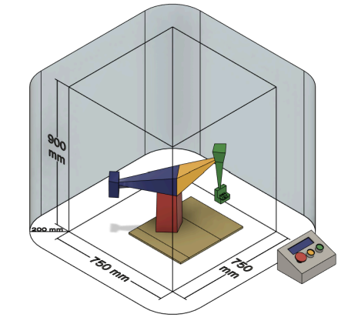
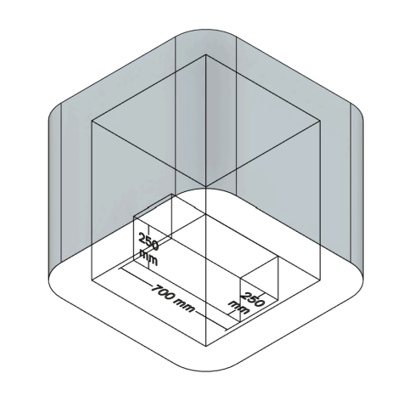
Competition Constraints

Slide 5
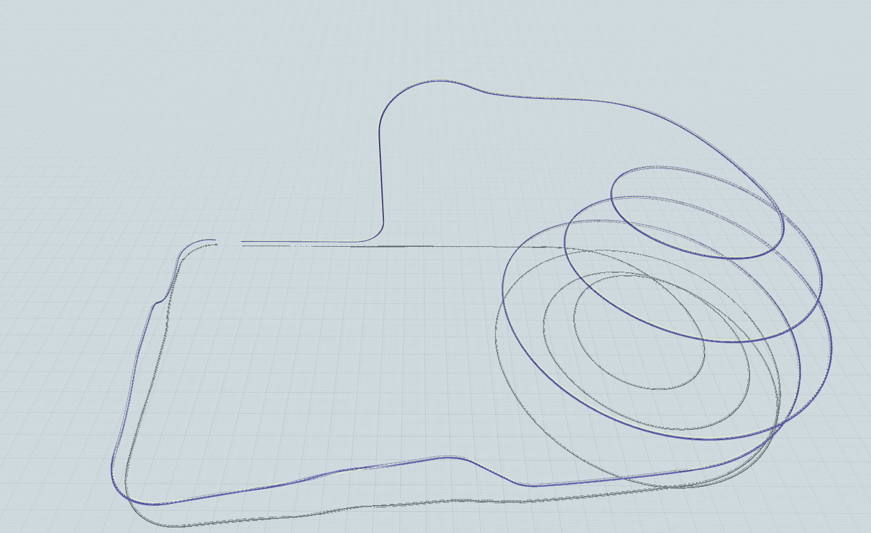
FVD++
Notes:
Toucan inspired ride with riders hanging off the sides

Slide 6
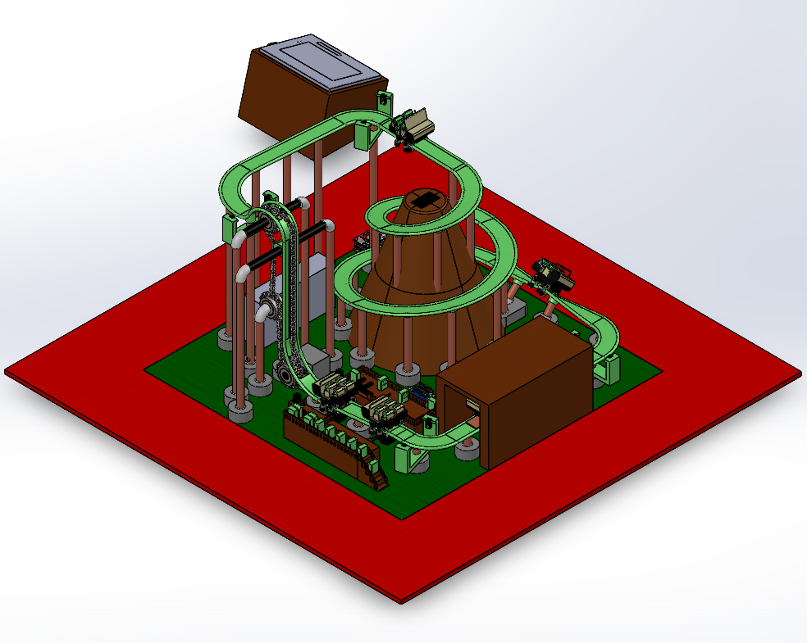
SolidWorks

Slide 7
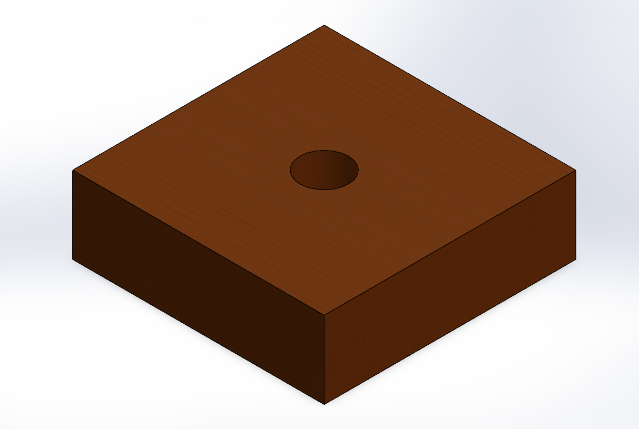
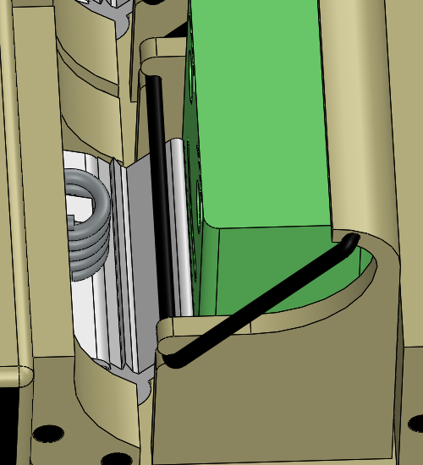
Modifications
Support Bases: Quikrete → Wood
Ratcheting Lap Bar Mechanism (White color for contrast)
Notes:
White in lap bar is shown for contrast

Slide 8
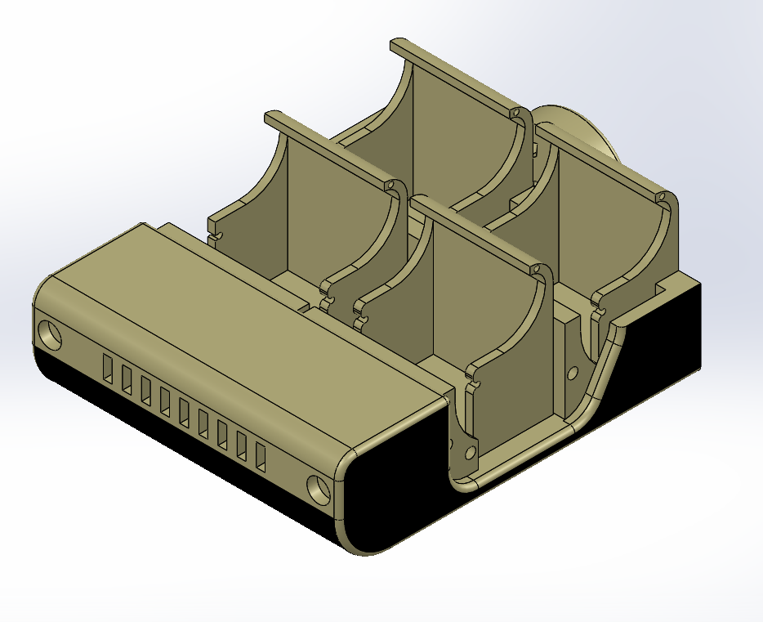
Modifications
Realistic Design for Frame

Slide 9
Q/A

Slide 10
Theory of Operation
Ride System Overview
Mechanical Subsystems
Sensor System
Control Architecture

Slide 11
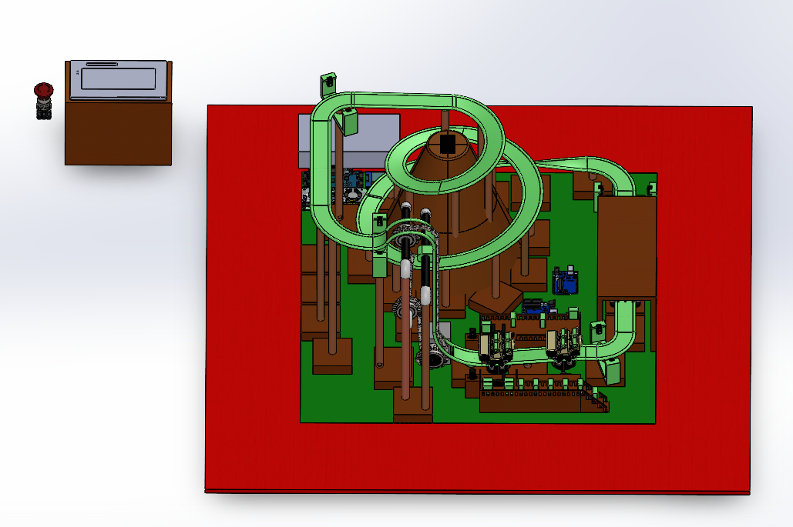
Ride System Overview

Slide 12

Mechanical Subsystems
Ride Vehicle
2 cars
4 people per car
Locking and latching restraints
Station
Servo-motor driven ride gates
Friction wheels
Lift hill
90$°$ Vertical Lift Hill
Chain-Driven
Servo Motor
Helix
Volcano
Fog Machine
Music
45 Degree Banked Turn
Thrill
Magnetic Braking Section
Neodymium magnets
Break Beam Infrared Sensors
Time
Speed

Slide 13
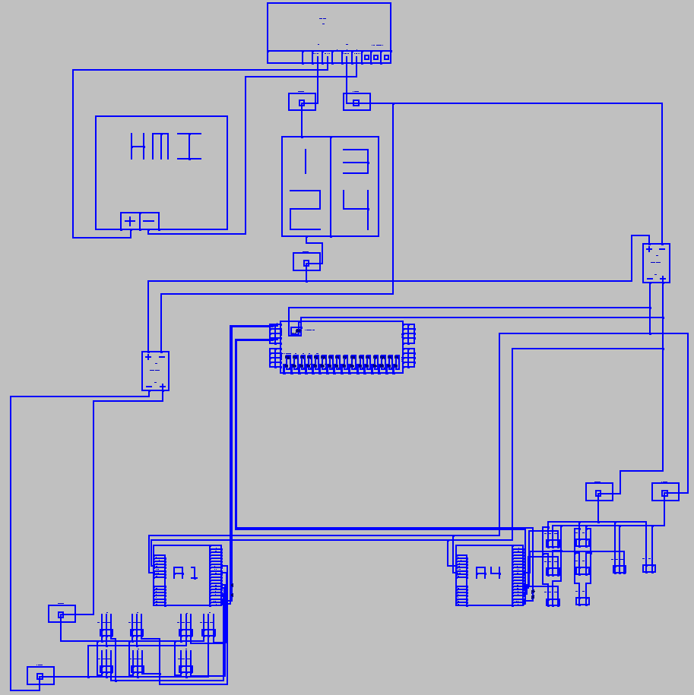
Control System Schematic

Slide 14
Q/A

Slide 15
ASTM Compliance
Track Analysis
Support Column Analysis
Safety Protocols

Slide 16
Track Analysis
Complete Data Table
Restraint Class
Resultant Deflection
Normal and Lateral Deflection
Velocity
Lap Bar Force

Slide 17
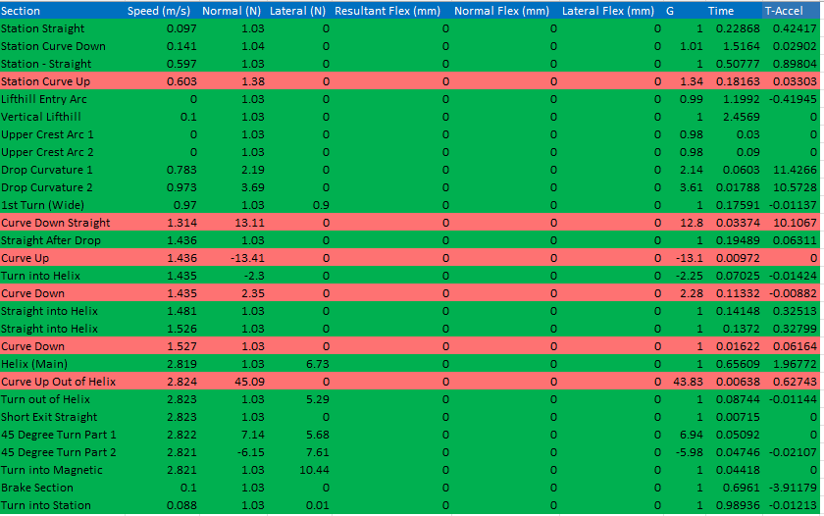
Complete Data Table
Notes:
Green: all sections where G forces are calculated normally in regard to the rider
Red: sections where G forces are considered Jerks (12.73, -13.02, and 43.78)
Jerk: The transition time between accelerations must be at least 0.2 s
Total time: 9.77 seconds for track
G force reversals
-1.08 G forces and then to positive 2 G limits to how quickly you can reverse those.

Slide 18
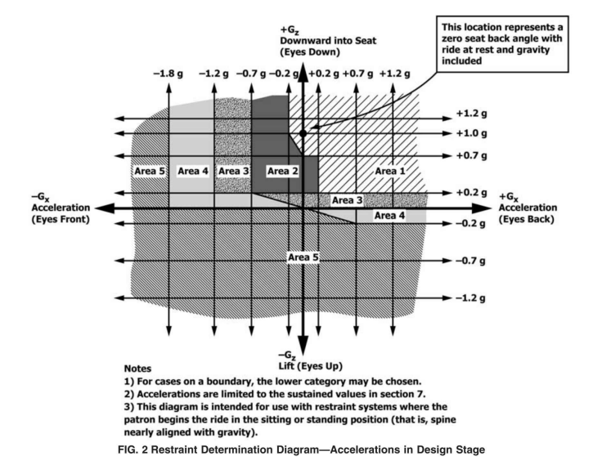
Restraint Class Analysis
Notes:
Currently we have class 4, we decided to manufacture class 5 restraint due to jerk motions which are not accounted for in the restraint classification
A lot of the times, restraint class is a driving variable in ride design.
Guest requirement wasn’t a driving ride restraint. We had the liberty to do a class 5 restraint. If you can get away with a class 4 restraint get away with that.

Slide 19
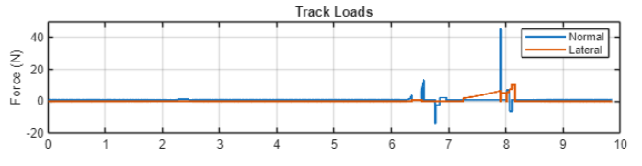
Normal and Lateral Force

Slide 20
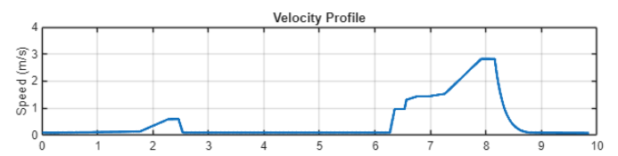
Velocity Analysis
Total Time: 9.77 seconds

Slide 21
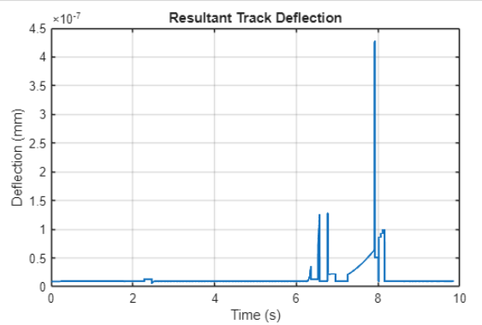
Resultant Deflection

Slide 22
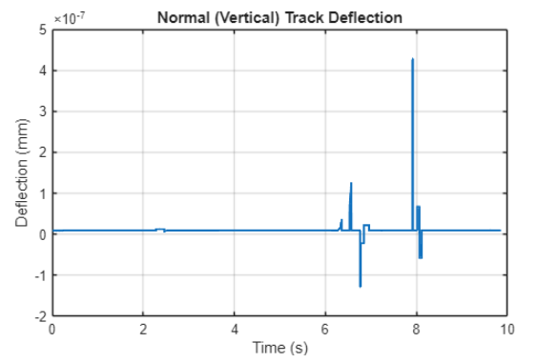
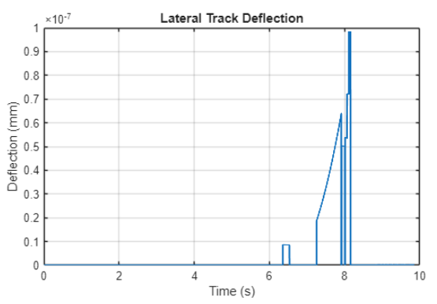
Normal and Lateral Deflection
Notes:
Normal and lateral track deflections:
Low
Within allowable limits
Short spikes (not sustained)

Slide 23
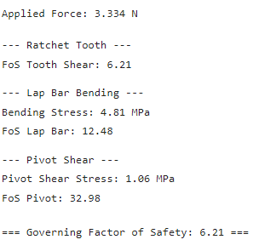
Primary Lap Bar Force Analysis

Slide 24
Q/A

Slide 25
Support Column Analysis
SN Curve
ANSYS
Buckling
Tipping
Fatigue
Guide Sprocket

Slide 26
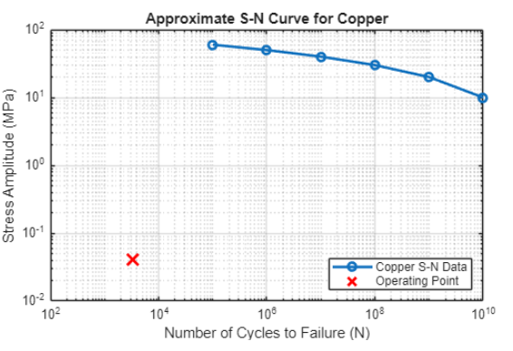
SN Curve
Data from:
Copper Development Association Inc. “Fatigue Strength.” Industrial Design Guide, Copper.org

Slide 27
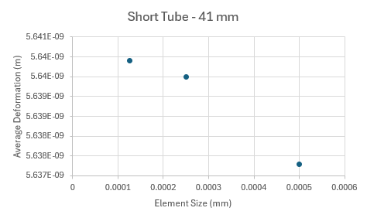
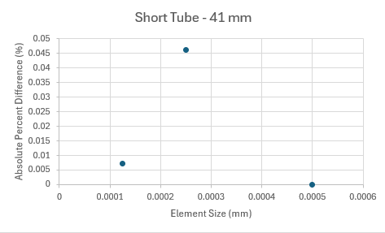
ANSYS – Shortest Tube – 41 mm
Deformation
Absolute Percent Difference (<5%)
Notes:
Left: Deformation
Right: percent deformation

Slide 28
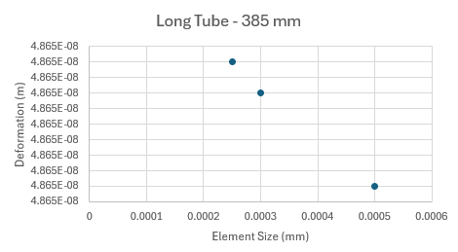
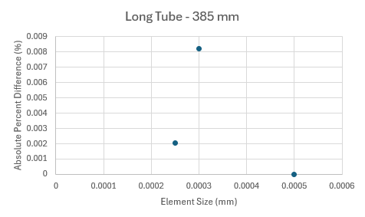
ANSYS – Longest Tube – 385 mm
Deformation
Absolute Percent Difference (<5%)
Notes:
Left: Deformation
Right: percent deformation

Slide 29
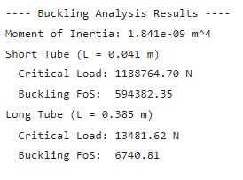
Buckling Analysis

Slide 30
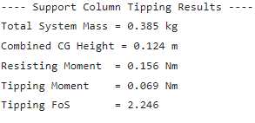
Tipping Analysis
Largest Support Column: 385 mm

Slide 31
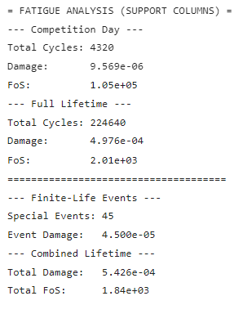
Fatigue Analysis
Largest Support Column: 385 mm
Notes:
Maintenance (10 events per year) and emergency stop (5 events per year)

Slide 32
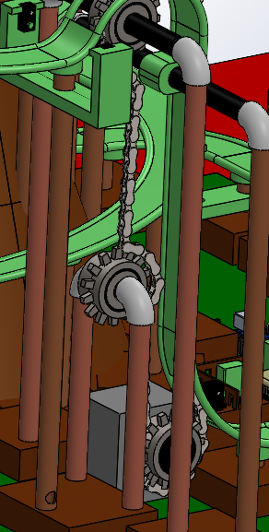
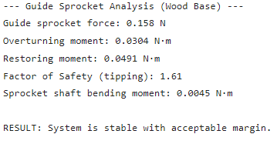
Guide Sprocket Analysis

Slide 33
Q/A

Slide 34
Safety Protocols
Standard Operating Procedure
Sensor Failure Procedure
Automated Forced Stop Procedure

Slide 35
Q/A

Slide 36
Future Plans
Complete Rider Acceleration Graphs and SolidWorks Drawings
Spring Break: March 13 (Friday) to March 22 (Sunday)
March 22: Final Hand Ins and Bag and Tag [REC: March 29]
March 28: Poster and Video Theory of Ops [REC: April 4]
Feb 21: Final Design Review, Theory of Ops, and ASTM F2291 Compliance [REC: Feb 28]

Slide 37



